Slide 1
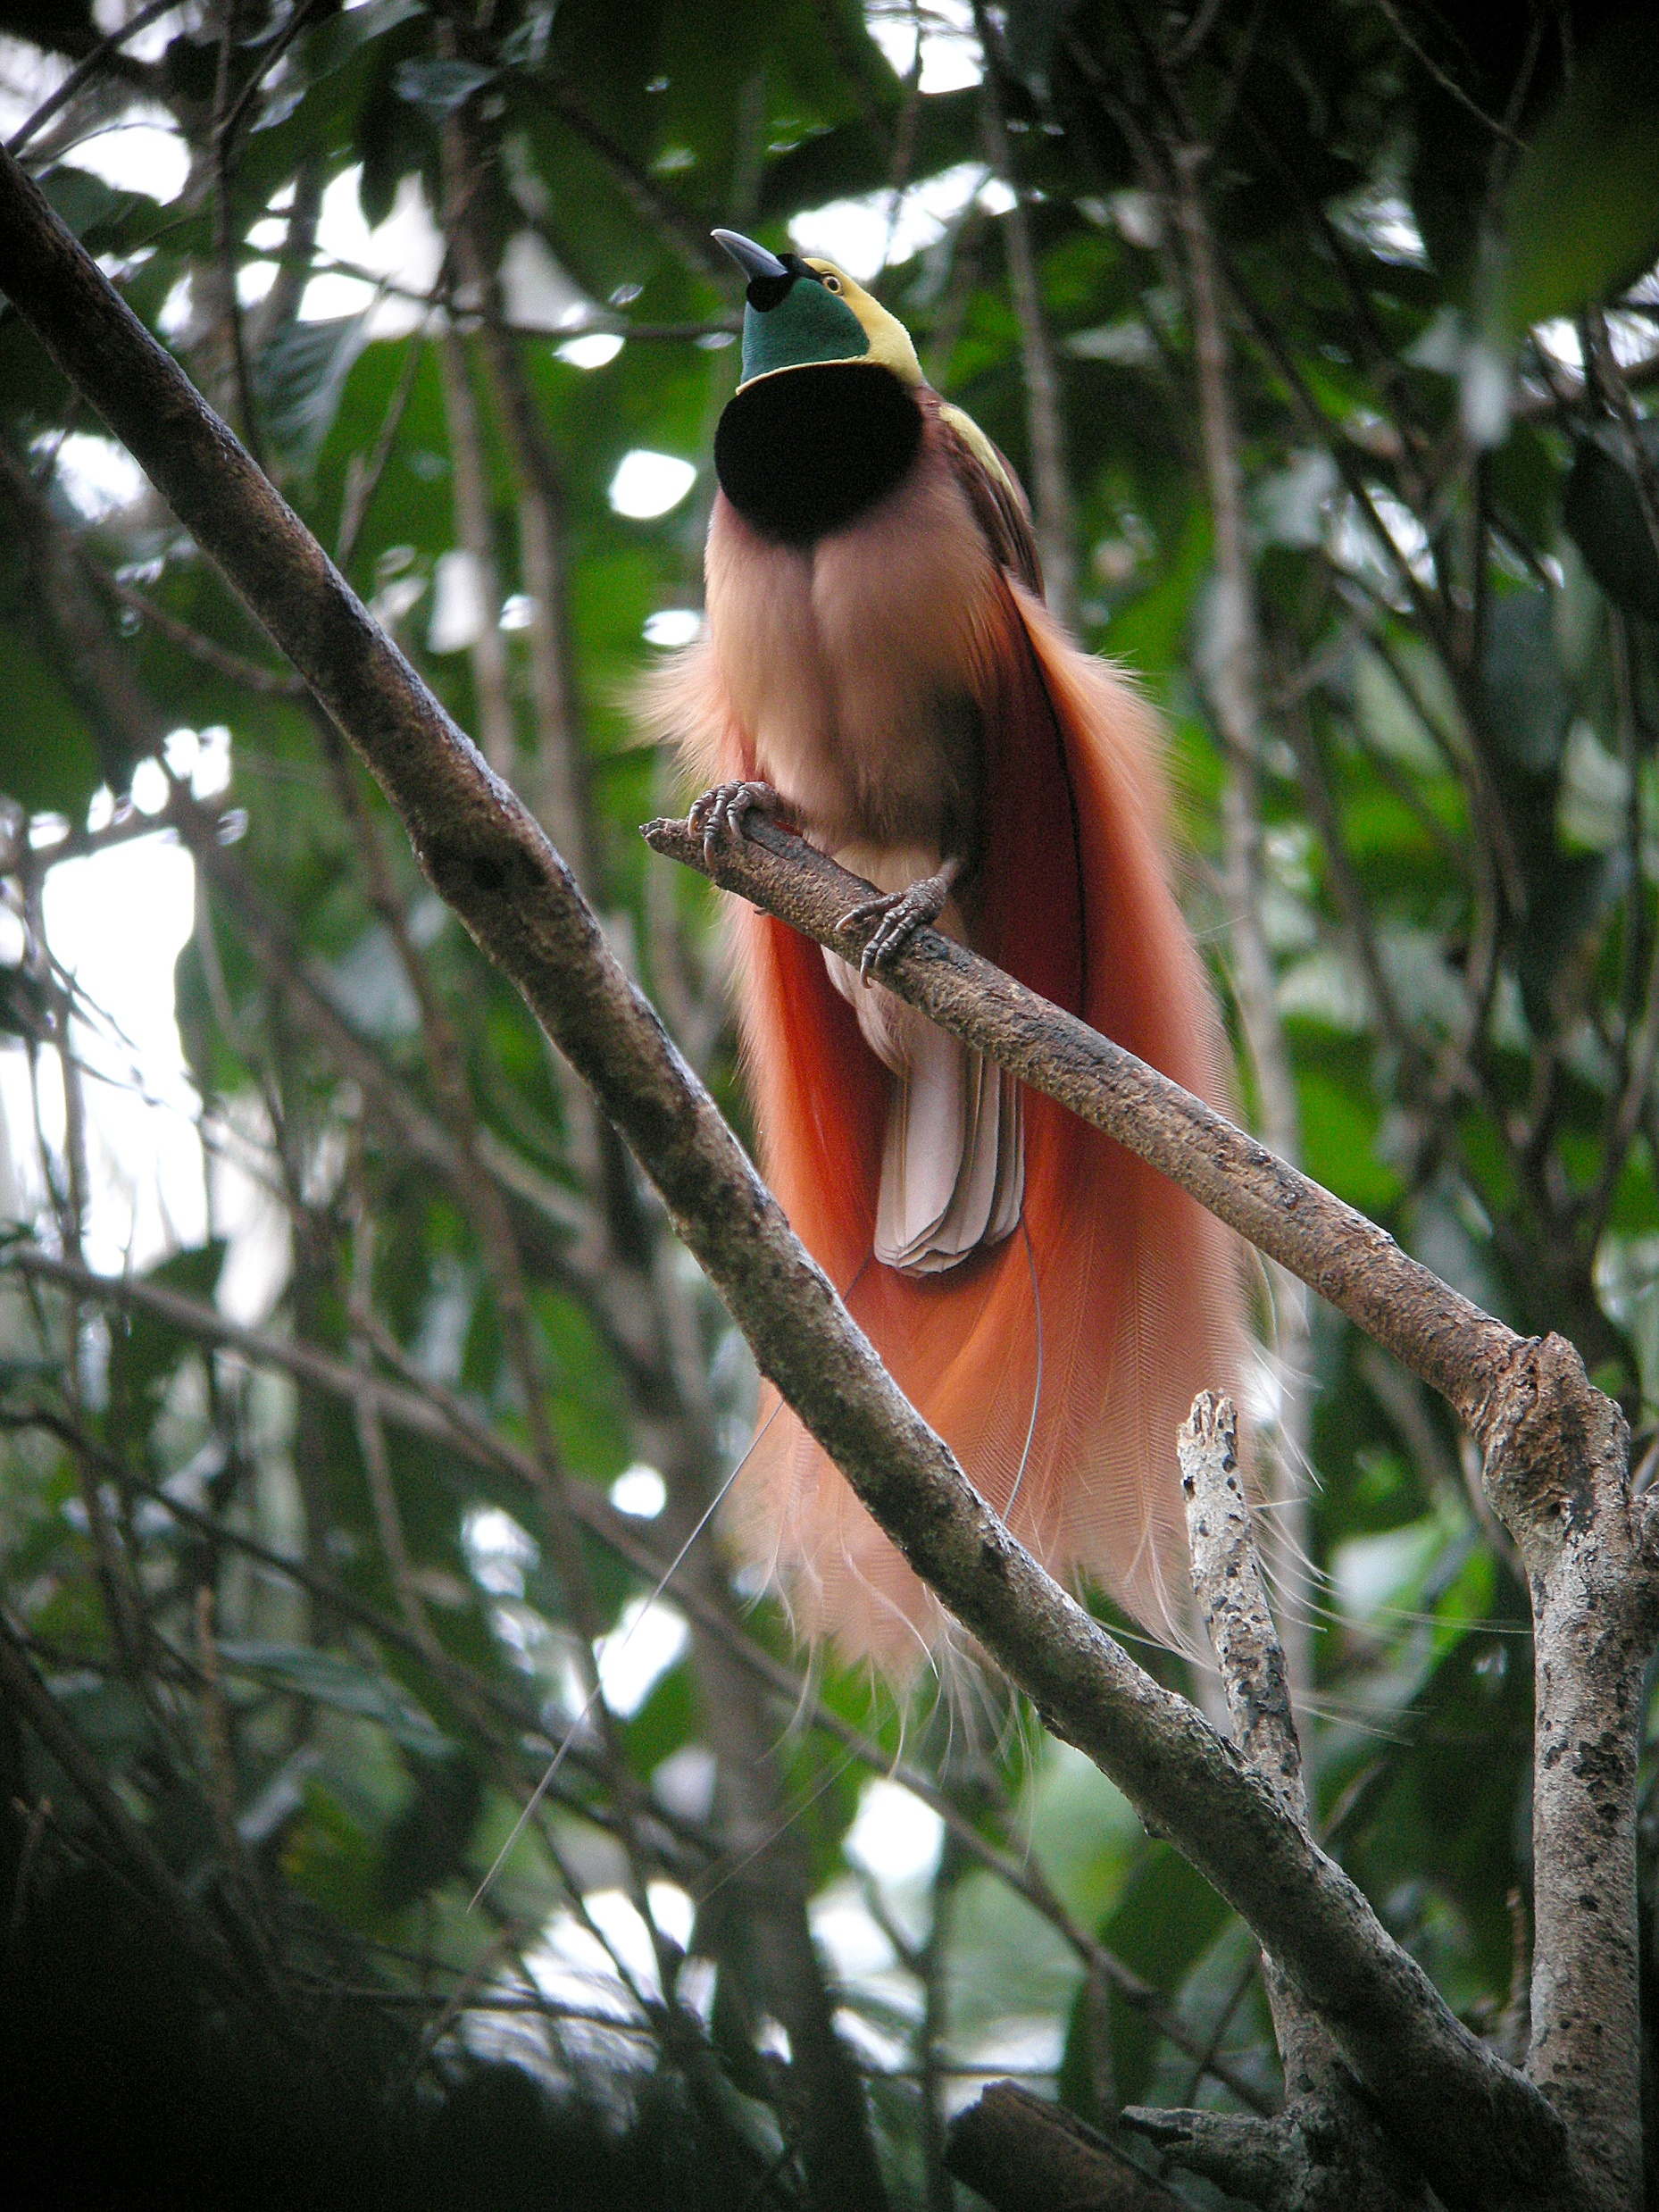
Multi-season occupancy models

Slide 2

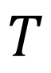
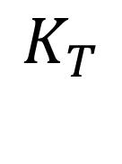
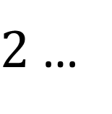
For single-season occupancy models
101
000
$$T$$
100
000
111
000
$$1$$
$2$ …
$$K_{T}$$
Closure at the species level

Slide 3
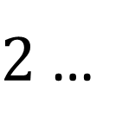
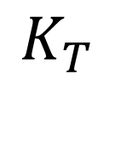
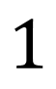

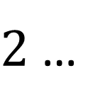
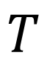
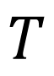
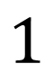
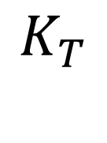
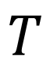
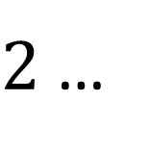
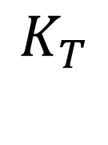
For multi-season occupancy models
Open at the species level
Open at the species level
$$T$$
$$T$$
$$T$$
$$1$$
$2$ …
$$K_{T}$$
$$1$$
$2$ …
$$K_{T}$$
$$1$$
$2$ …
$$K_{T}$$
Closed at the species level
Closed at the species level
Closed at the species level

Slide 4
For multi-season occupancy models
Colonisation?
Colonisation?
Extinction?
Extinction?
$$T$$
$$T$$
$$T$$
$$1$$
$2$ …
$$K_{T}$$
$$1$$
$2$ …
$$K_{T}$$
$$1$$
$2$ …
$$K_{T}$$
Closed at the species level
Closed at the species level
Closed at the species level

Slide 5
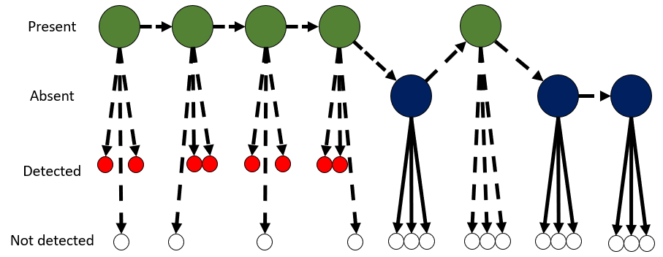
For multi-season occupancy models
We monitor each site over multiple seasons
And we survey each site multiple times within a season
101
000
101
000
100
000
100
000
111
111
000
000
8 seasons of surveying the purple site

Slide 6
Open CMR and multi-season occupancy models are almost the same thing
But what changes?

Slide 7
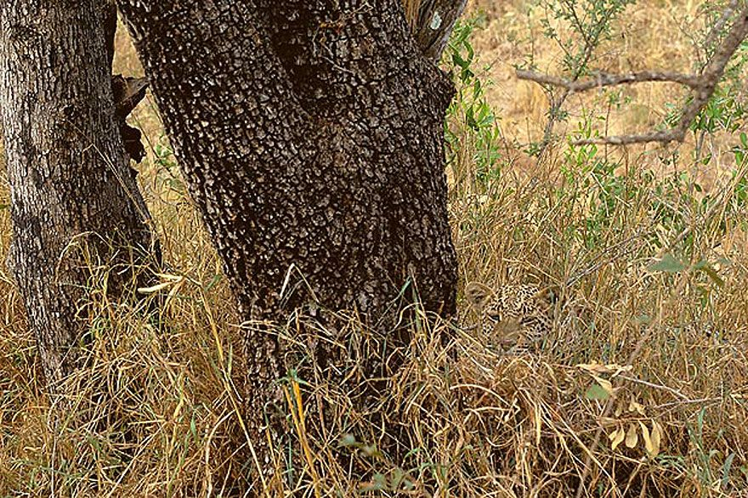
Individual capture history for a leopard
Alive
State process
Dead
Seen
Observation process
Not seen
Stochastic process (i.e. a biased coin flip)
Deterministic process (i.e. certain)

Slide 8
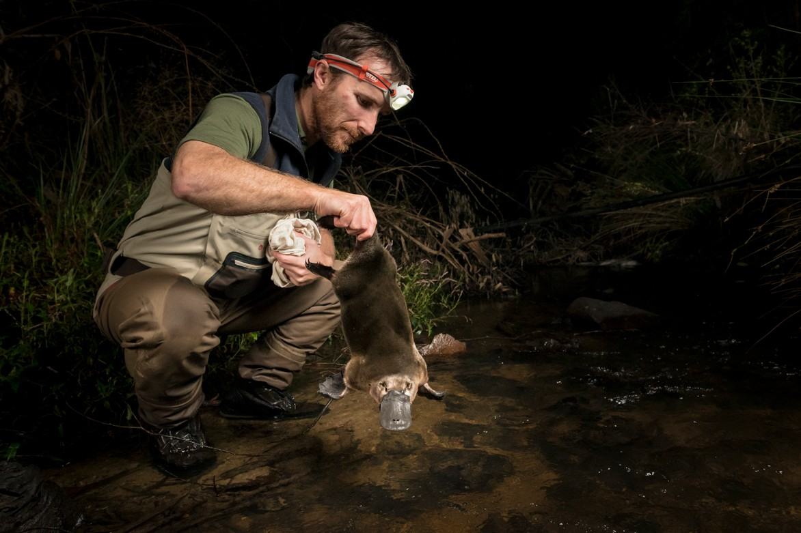
Detection histories for a site
Present
State process
Absent
Detected
Observation process
Not detected
Stochastic process (i.e. a biased coin flip)
Deterministic process (i.e. certain)

Slide 9
Detection histories for a site
Present
State process
Absent
Detected
Observation process
Not detected
Stochastic process (i.e. a biased coin flip)
Deterministic process (i.e. certain)

Slide 10
Detection histories for a site
Present
State process
Absent
Detected
Observation process
Not detected
Stochastic process (i.e. a biased coin flip)
Deterministic process (i.e. certain)

Slide 11
The biggest difference; Zombie sites
8 seasons of surveying the a site
Occupancy models;
The initial state of the site is not guaranteed
There might be no platypuses when you go to a site
If a site was unoccupied, the next time you visit, it may have been colonised
If a site was occupied, the next time you visit, it may have gone extinct
Note that this does not mean the entire species has gone extinct, just the population at a given site

Slide 12

The four parameters ($ψ,γ,ε,p$)

Slide 13


1; $ψ$ (psi) or Initial occupancy probability
$Ψ$ is tasked with the simple task of figuring out if the site was occupied the first time you visited it
$$ψ$$

Slide 14

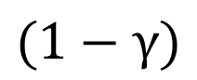
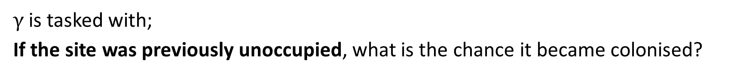
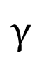
2; $γ$ (gamma) or Colonisation probability
$γ$ is tasked with;
If the site was previously unoccupied, what is the chance it became colonised?
$$γ$$
$$(1−γ)$$

Slide 15
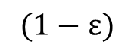

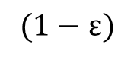
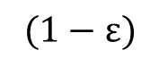
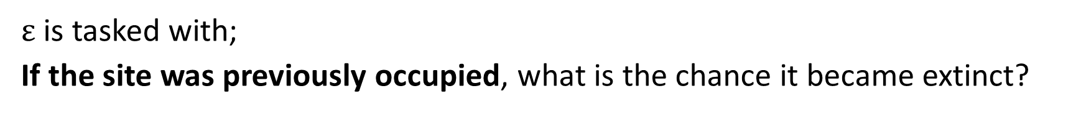
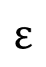
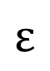
3; $ε$ (epsilon) or Extinction probability
$ε$ is tasked with;
If the site was previously occupied, what is the chance it became extinct?
$$(1−ε)$$
$$(1−ε)$$
$$(1−ε)$$
$$ε$$
$$ε$$

Slide 16
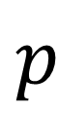
4; 𝑝 or Detection probability
𝑝 is tasked with;
Conditional on the assumed state, what is the chance a site was correctly detected?
$$\text{p}$$

Slide 17
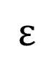
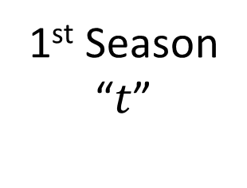
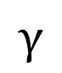
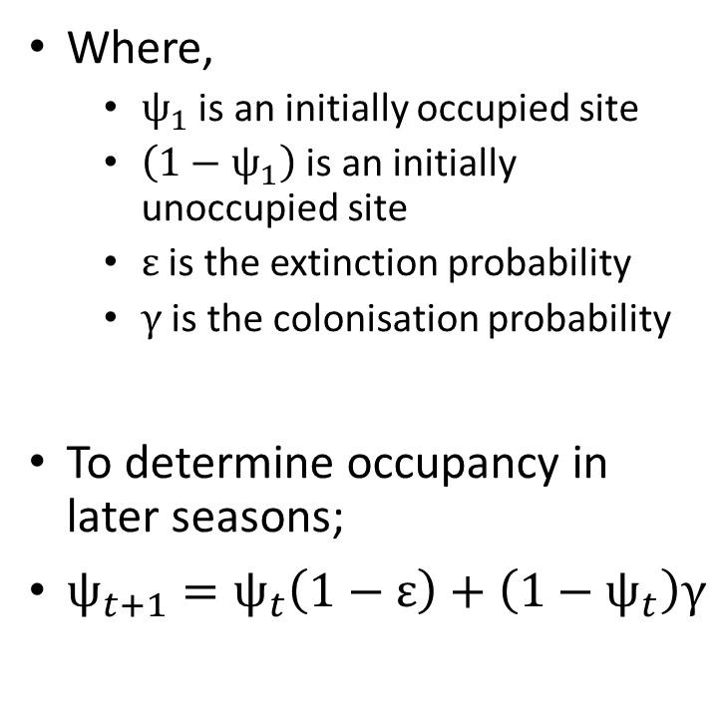
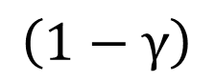
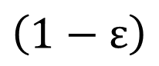
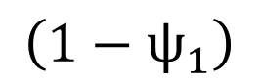
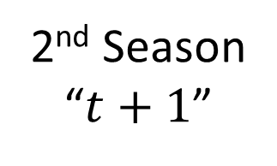
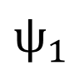
How do we figure out whether a site was occupied later on?
Where,
$ψ_{1}$ is an initially occupied site
$\left(1−ψ_{1}\right)$ is an initially unoccupied site
$ε$ is the extinction probability
$γ$ is the colonisation probability
To determine occupancy in later seasons;
$ψ_{t+1}=ψ_{t}\left(1−ε\right)+\left(1−ψ_{t}\right)γ$
1st Season “$t$”
2nd Season
“$t+1$”
Present
$$\left(1−ε\right)$$
Present
$$ψ_{1}$$
$$ε$$
$$γ$$
Absent
Absent
$$\left(1−ψ_{1}\right)$$
Remember, “+” means “OR” with probabilities
$$\left(1−γ\right)$$
If a site was unoccupied, was it successfully colonised?
If a site was occupied, did it fail to go extinct?

Slide 18
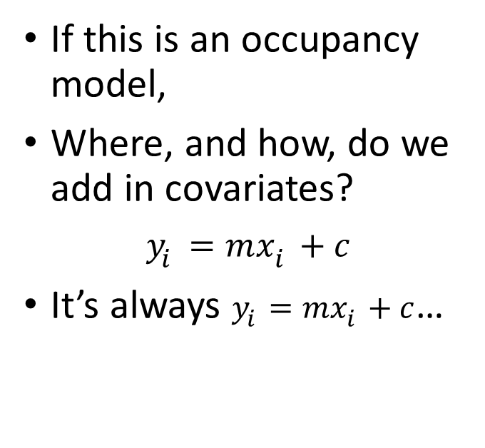
Including covariates in an occupancy model
1st Season “$t$”
2nd Season
“$t+1$”
If this is an occupancy model,
Where, and how, do we add in covariates?
$$y_{i}=mx_{i}+c$$
It’s always $y_{i}=mx_{i}+c$…
Present
$$\left(1−ε\right)$$
Present
$$ψ_{1}$$
$$ε$$
$$γ$$
Absent
Absent
$$\left(1−ψ_{1}\right)$$
$$\left(1−γ\right)$$

Slide 19
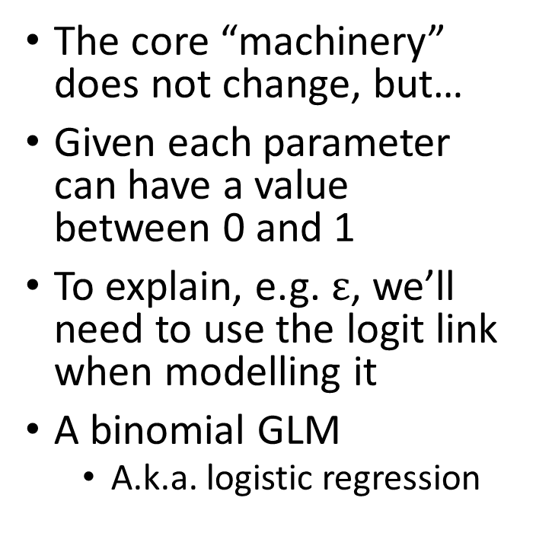
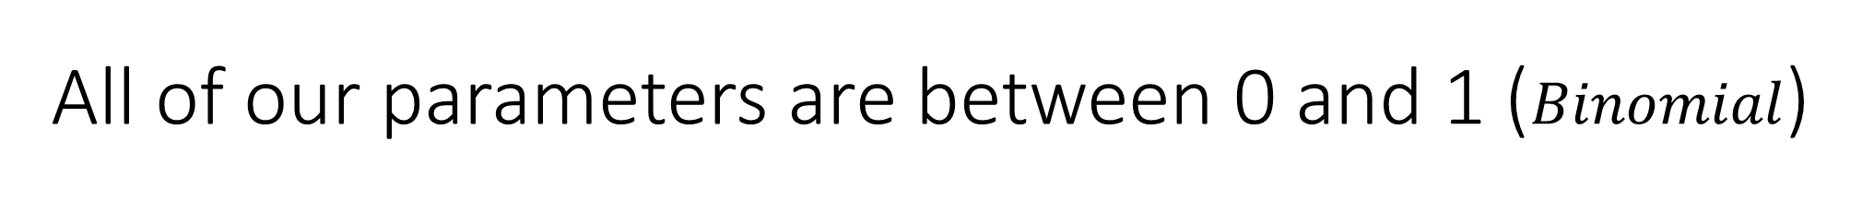
All of our parameters are between 0 and 1 ($Binomial$)
The core “machinery” does not change, but…
Given each parameter can have a value between 0 and 1
To explain, e.g. $ε$, we’ll need to use the logit link when modelling it
A binomial GLM
A.k.a. logistic regression
1st Season “$t$”
2nd Season
“$t+1$”
Present
$$\left(1−ε\right)$$
Present
$$ψ_{1}$$
$$ε$$
$$γ$$
Absent
Absent
$$\left(1−ψ_{1}\right)$$
$$\left(1−γ\right)$$

Slide 20

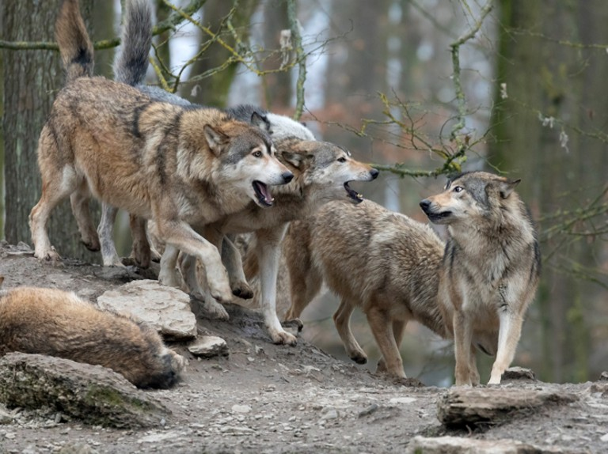


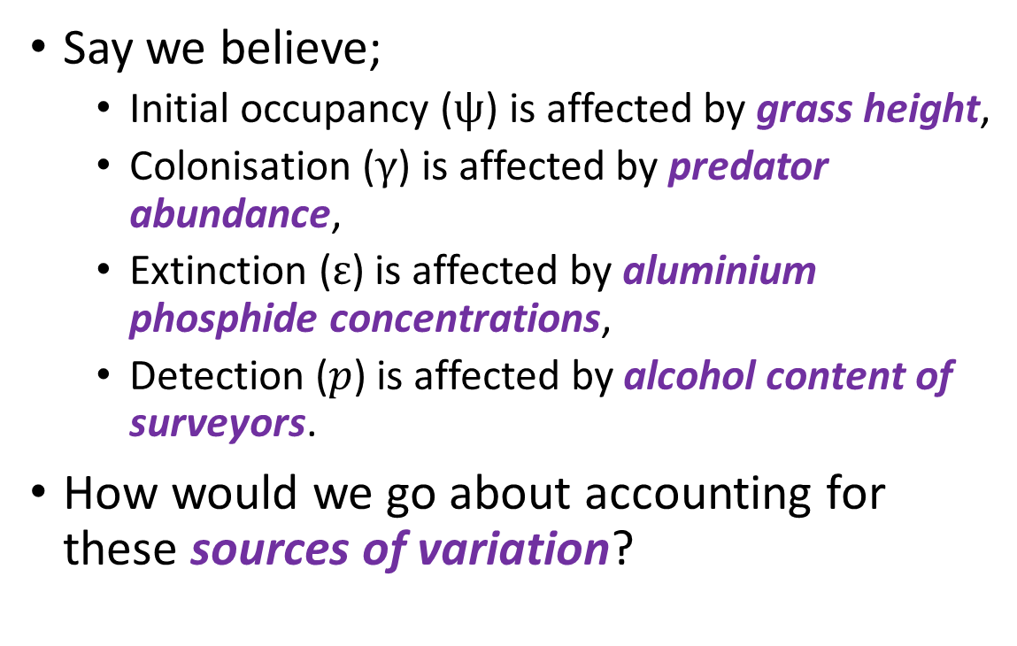
GLMs for each parameter
Say we believe;
Initial occupancy ($ψ$) is affected by grass height,
Colonisation ($γ$) is affected by predator abundance,
Extinction ($ε$) is affected by aluminium phosphide concentrations,
Detection ($p$) is affected by alcohol content of surveyors.
How would we go about accounting for these sources of variation?

Slide 21
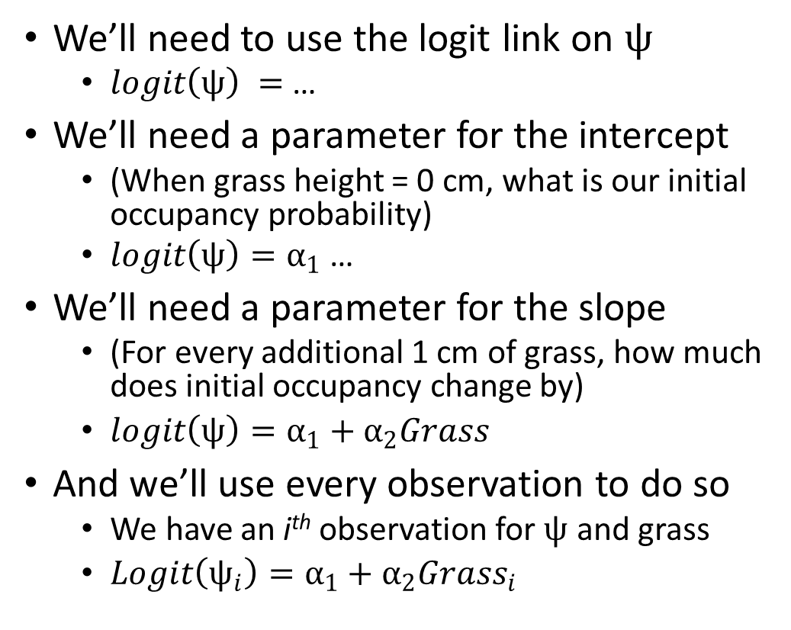

Initial occupancy ($ψ$) is affected by grass height
We’ll need to use the logit link on $ψ$
$logit\left(ψ\right) =$ …
We’ll need a parameter for the intercept
(When grass height = 0 cm, what is our initial occupancy probability)
$logit\left(ψ\right)=α_{1}$ …
We’ll need a parameter for the slope
(For every additional 1 cm of grass, how much does initial occupancy change by)
$logit\left(ψ\right)=α_{1}+α_{2}Grass$
And we’ll use every observation to do so
We have an i^{th} observation for $ψ$ and grass
$Logit\left(ψ_{i}\right)=α_{1}+α_{2}Grass_{i}$

Slide 22
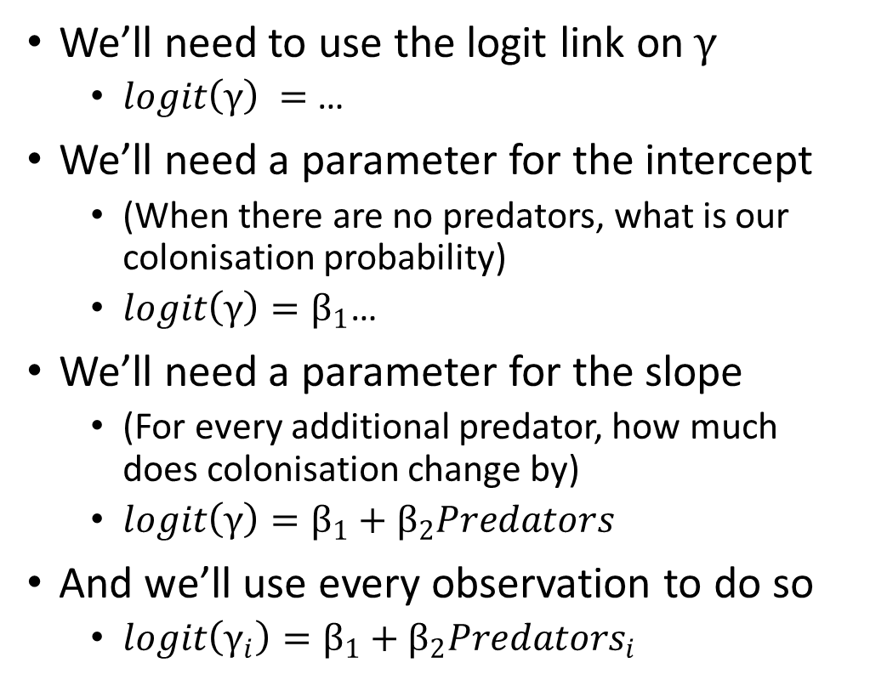

Colonisation ($γ$) is affected by predator abundance
We’ll need to use the logit link on$γ$
$logit\left(γ\right) =$ …
We’ll need a parameter for the intercept
(When there are no predators, what is our colonisation probability)
$logit\left(γ\right)=β_{1}$…
We’ll need a parameter for the slope
(For every additional predator, how much does colonisation change by)
$logit\left(γ\right)=β_{1}+β_{2}Predators$
And we’ll use every observation to do so
$logit\left(γ_{i}\right)=β_{1}+β_{2}Predators_{i}$

Slide 23
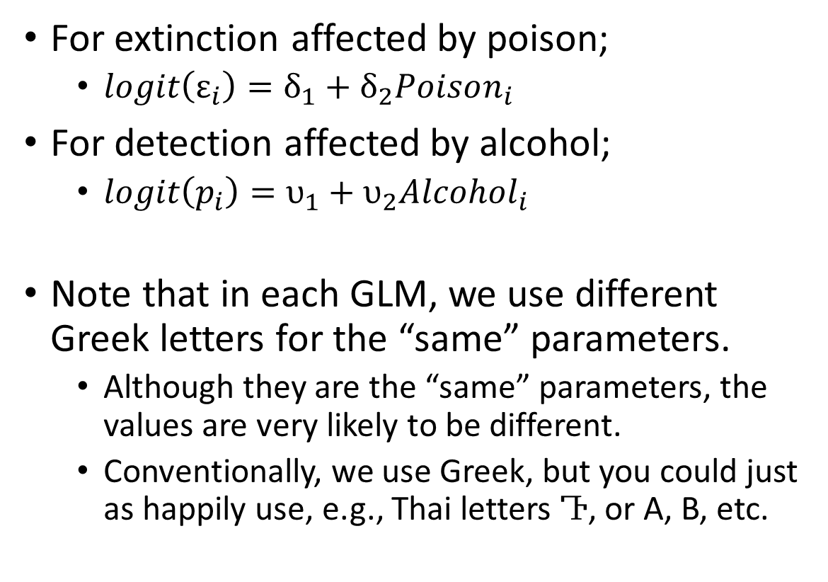

Extinction ($ε$) is affected by aluminium phosphide concentrations Detection ($p$) is affected by alcohol content of surveyors
For extinction affected by poison;
$logit\left(ε_{i}\right)=δ_{1}+δ_{2}Poison_{i}$
For detection affected by alcohol;
$logit\left(p_{i}\right)=υ_{1}+υ_{2}Alcohol_{i}$
Note that in each GLM, we use different Greek letters for the “same” parameters.
Although they are the “same” parameters, the values are very likely to be different.
Conventionally, we use Greek, but you could just as happily use, e.g., Thai letters Ⴅ, or A, B, etc.

Slide 24
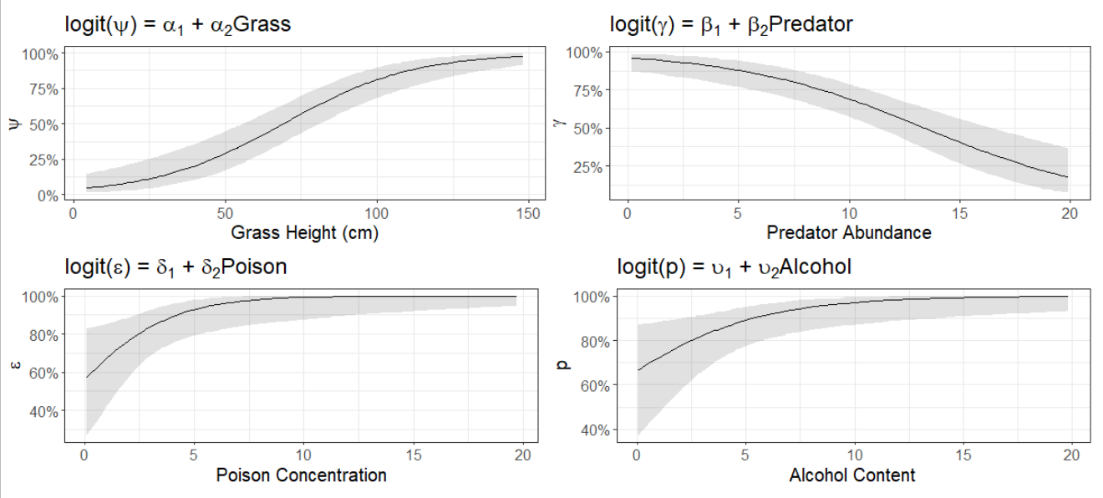
GLMs for each parameter

Slide 25
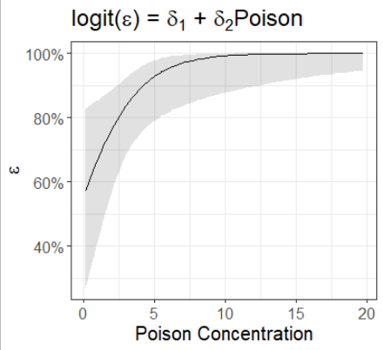
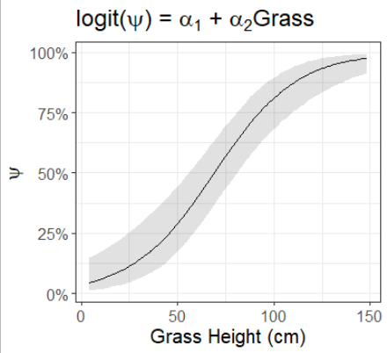
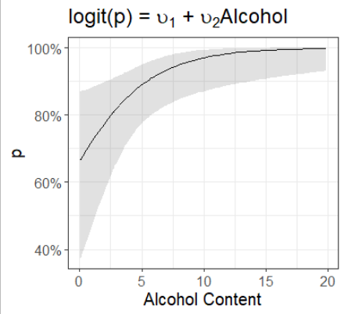
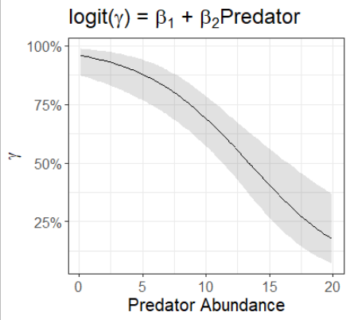








Bringing them all together
1st Season “$t$”
2nd Season
“$t+1$”
Present
$$\left(1−ε\right)$$
Present
$$ψ_{1}$$
$$ε$$
$$γ$$
Absent
Absent
$$\left(1−ψ_{1}\right)$$
$$\left(1−γ\right)$$

Slide 26

tl;dr
101
000
100
000
111
000
8 seasons of surveying the purple site

